Slide 1
Health Assistant
DESIGNING & PROTOTYPING SMART APPLICATIONS - SUMMER 2018
designed for a healthy life

Slide 2
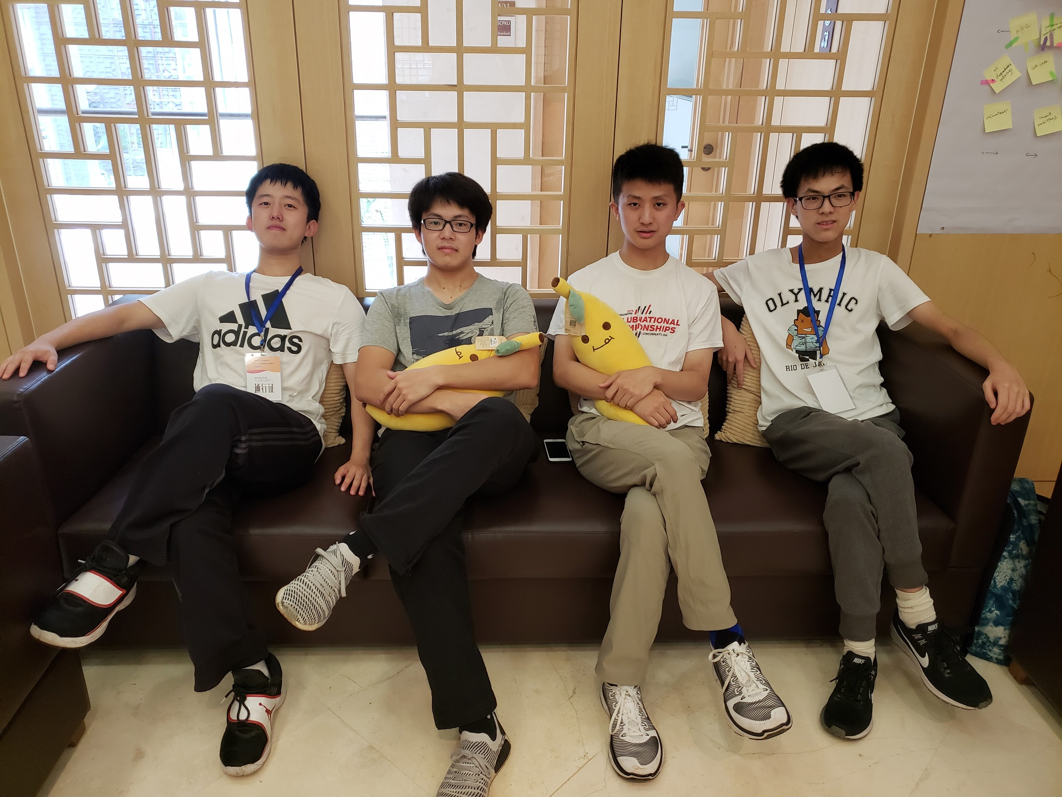

Hello!
We are Group
A！
Joseph Daniel Joe Bennet

Slide 3
PROCESS
NEEDFINDING
GENERATE POV
FIND HMW
FIND SOLUTION
PRODUCE EXPERIENCE PROTOTYPE
PRODUCE LOW-FI
PRODUCE MEDIUM-FI
USABILITY TEST

Slide 4
Needfinding
7.23-7.24 Mon & Tue

Slide 5
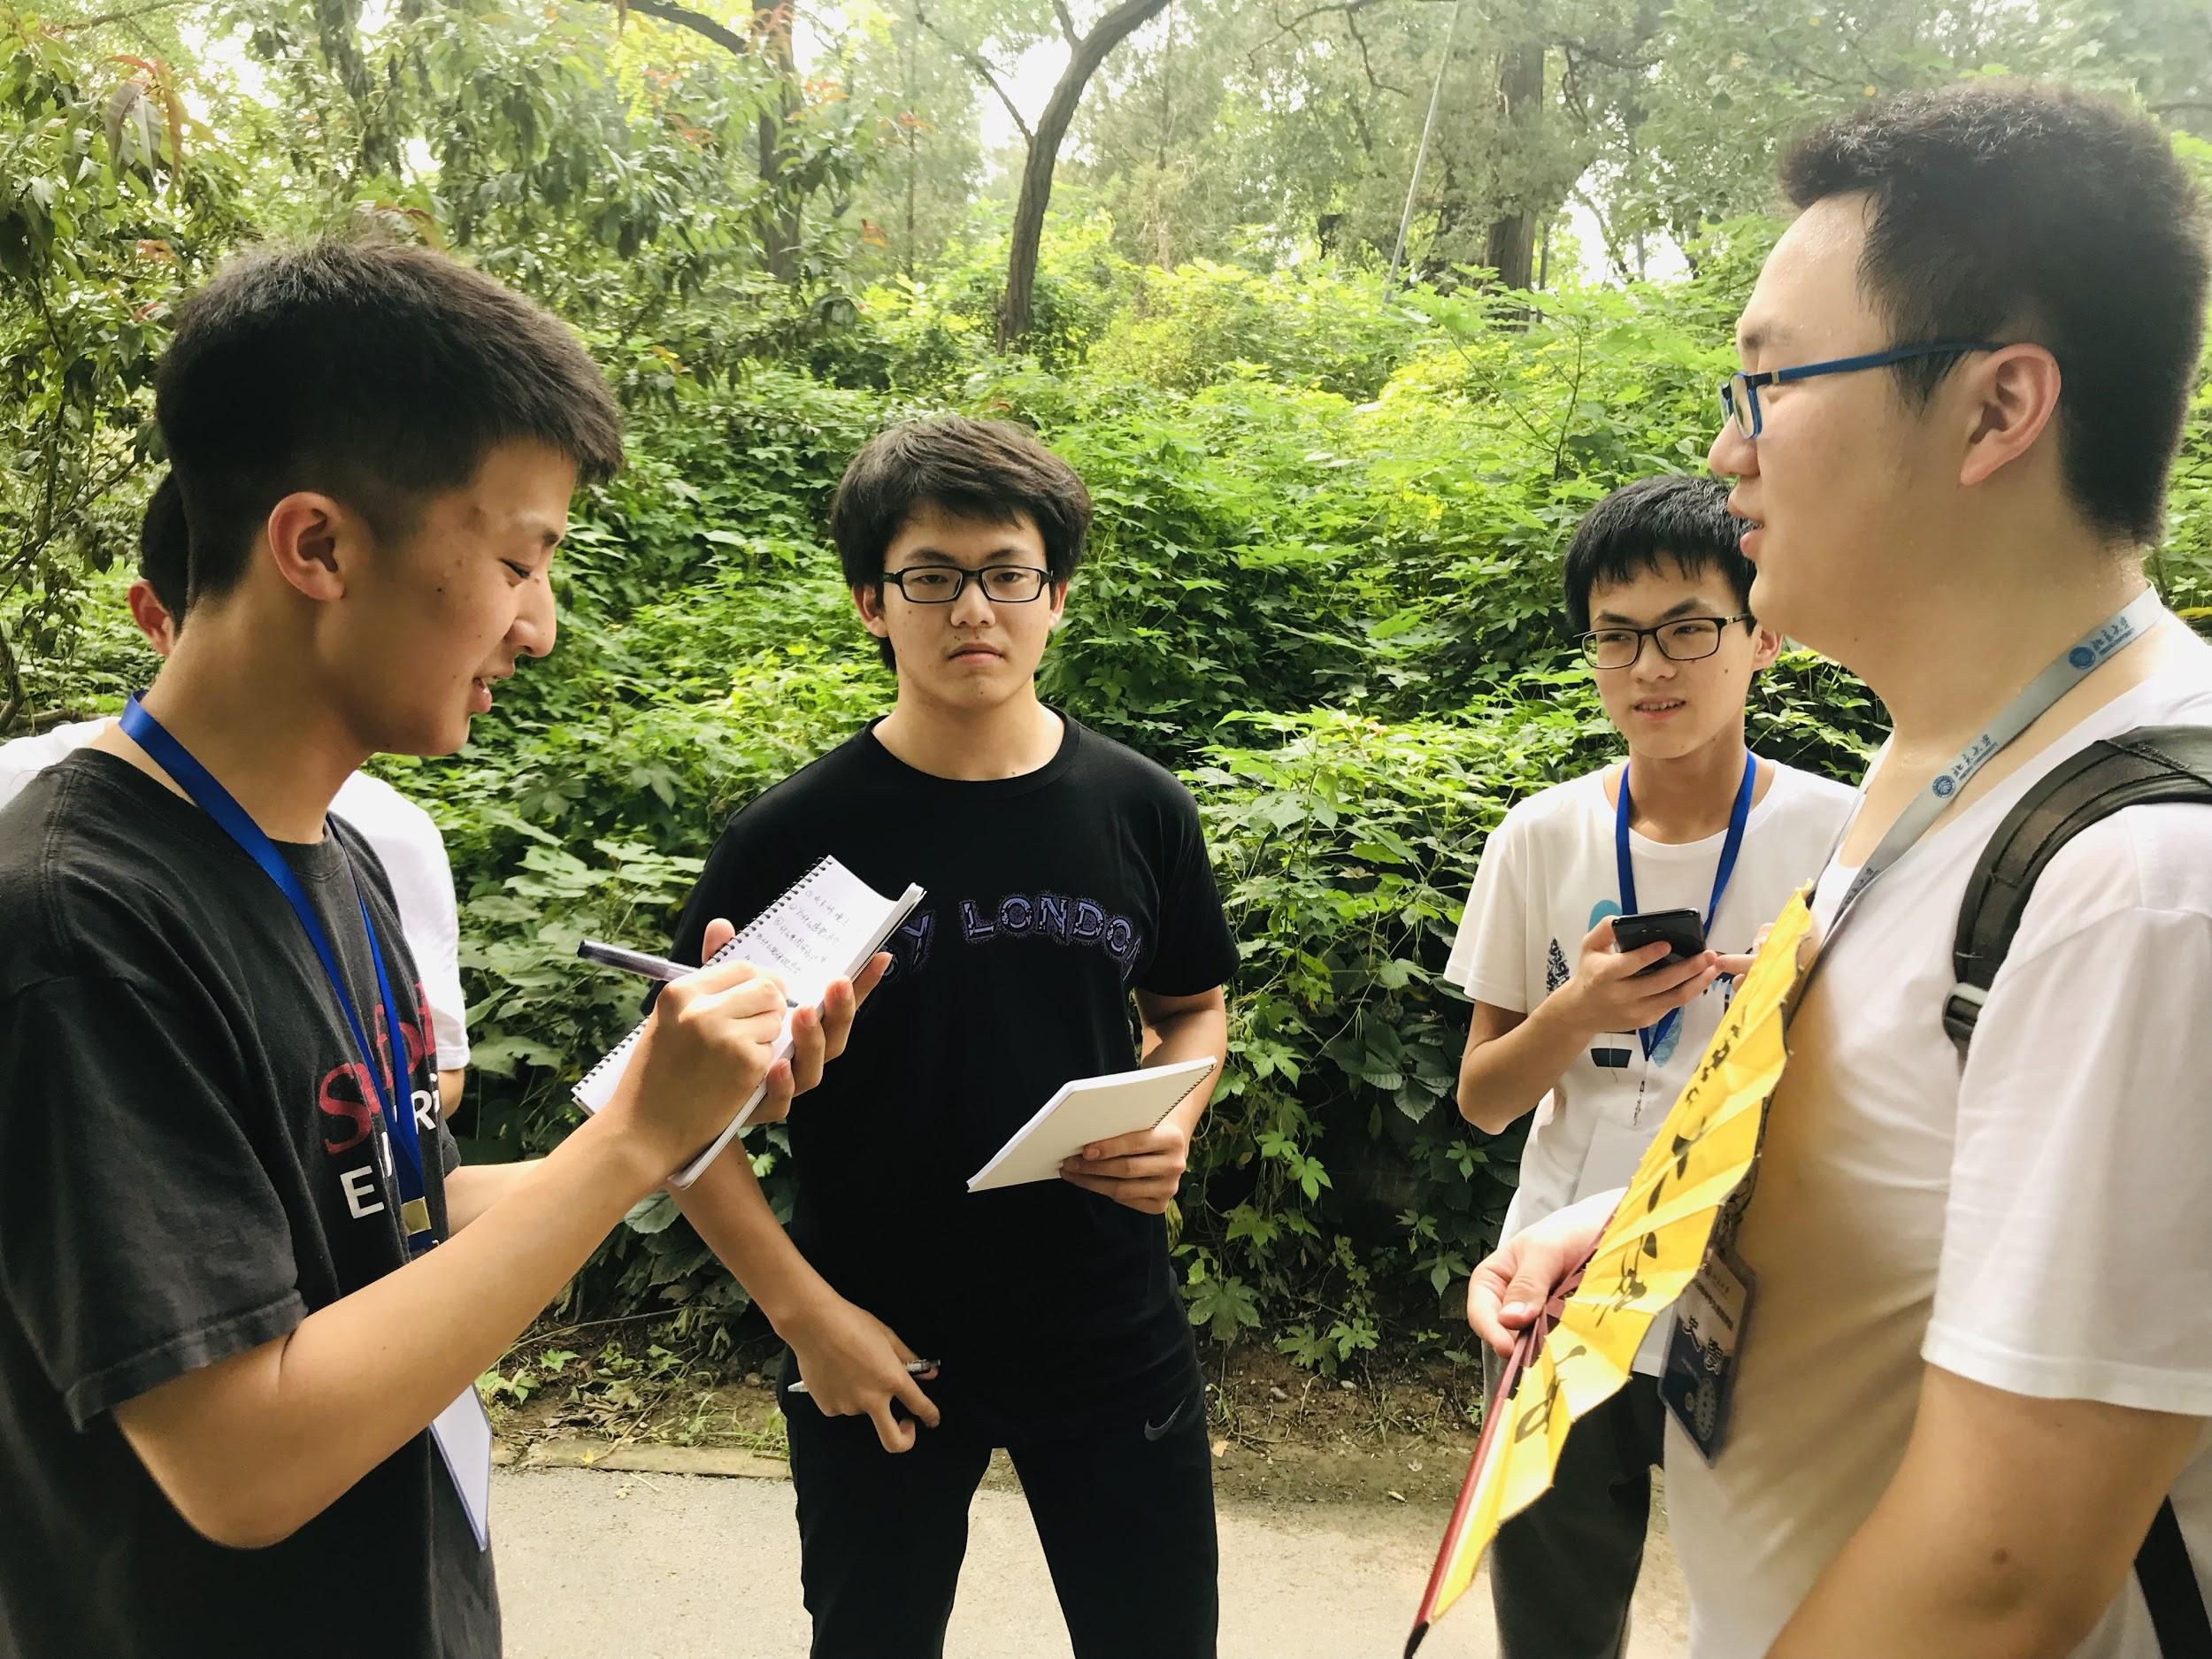
Tom, from Shandong, is a student visiting in the Peking campus.
“
In fact, recently the environment is not so bad, but the pollution of air is always the biggest problem. It might be resulted from smog and sand storm. The smog is actually caused by the overlarged number of private cars, which might be evaded with enacting policies to limit traffic by the government.
”
Notes:
In fact, recently the environment is not so bad, but the pollution of air is always the biggest problem. It might be resulted from smog and sand storm. The smog is actually caused by the overlarged number of private cars, which might be evaded with enacting policies to limit traffic by the government.

Slide 6
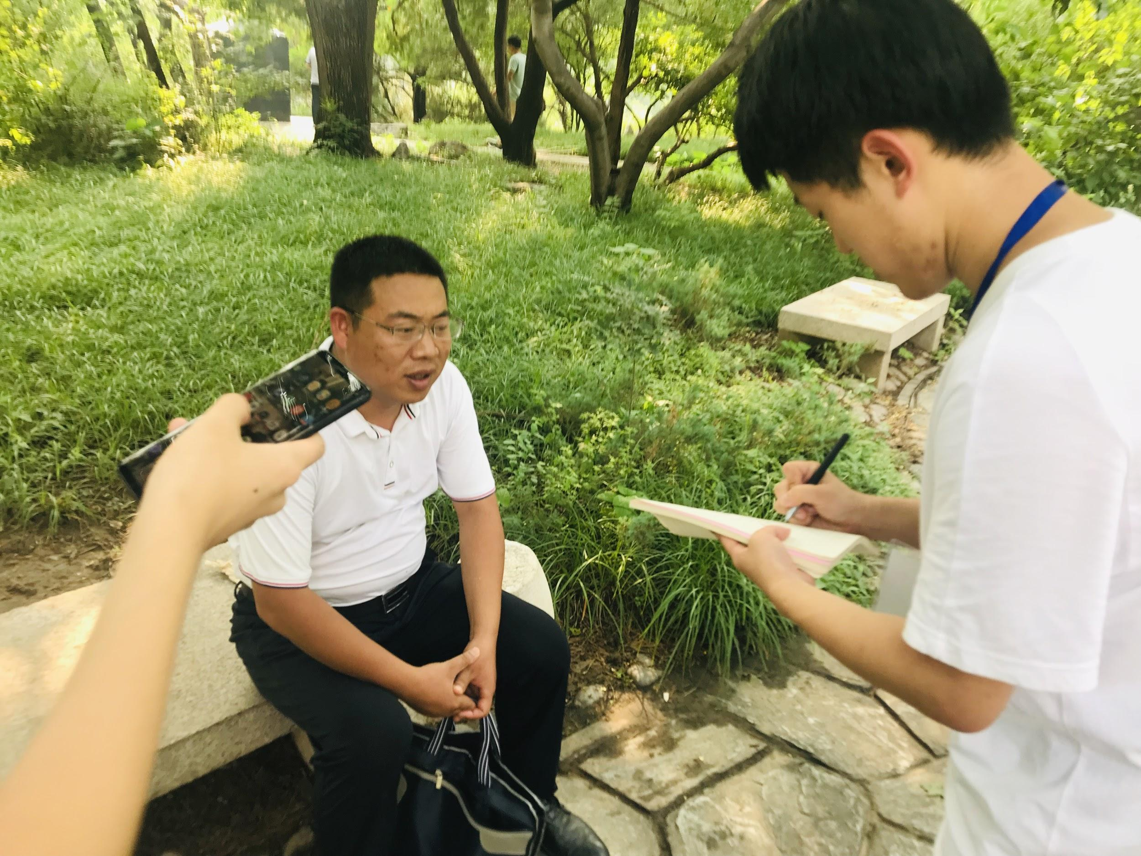
PETER, A MIDDLE AGED MAN FROM SHANDONG, CONCERNED ABOUT THE ENVIRONMENT
“
…...….I don't think the environment in Beijing has been improved so far. The bad opaque air drives one's mind mad and influences while commuting………..for the street food, whose quality cannot be secured, it is actually what customers mainly concern.
”
Notes:
Viewing the general smog and obtaining information through weather forecast, I don't think the environment in Beijing has been improved so far. The bad opaque air drives one's mind mad and influences while commuting. The government should take the responsibility and do something effective to improve it. What’s more, the food is delicate in some dignified restaurants. But for the street food, whose quality cannot be secured, it is actually what customers mainly concern.

Slide 7
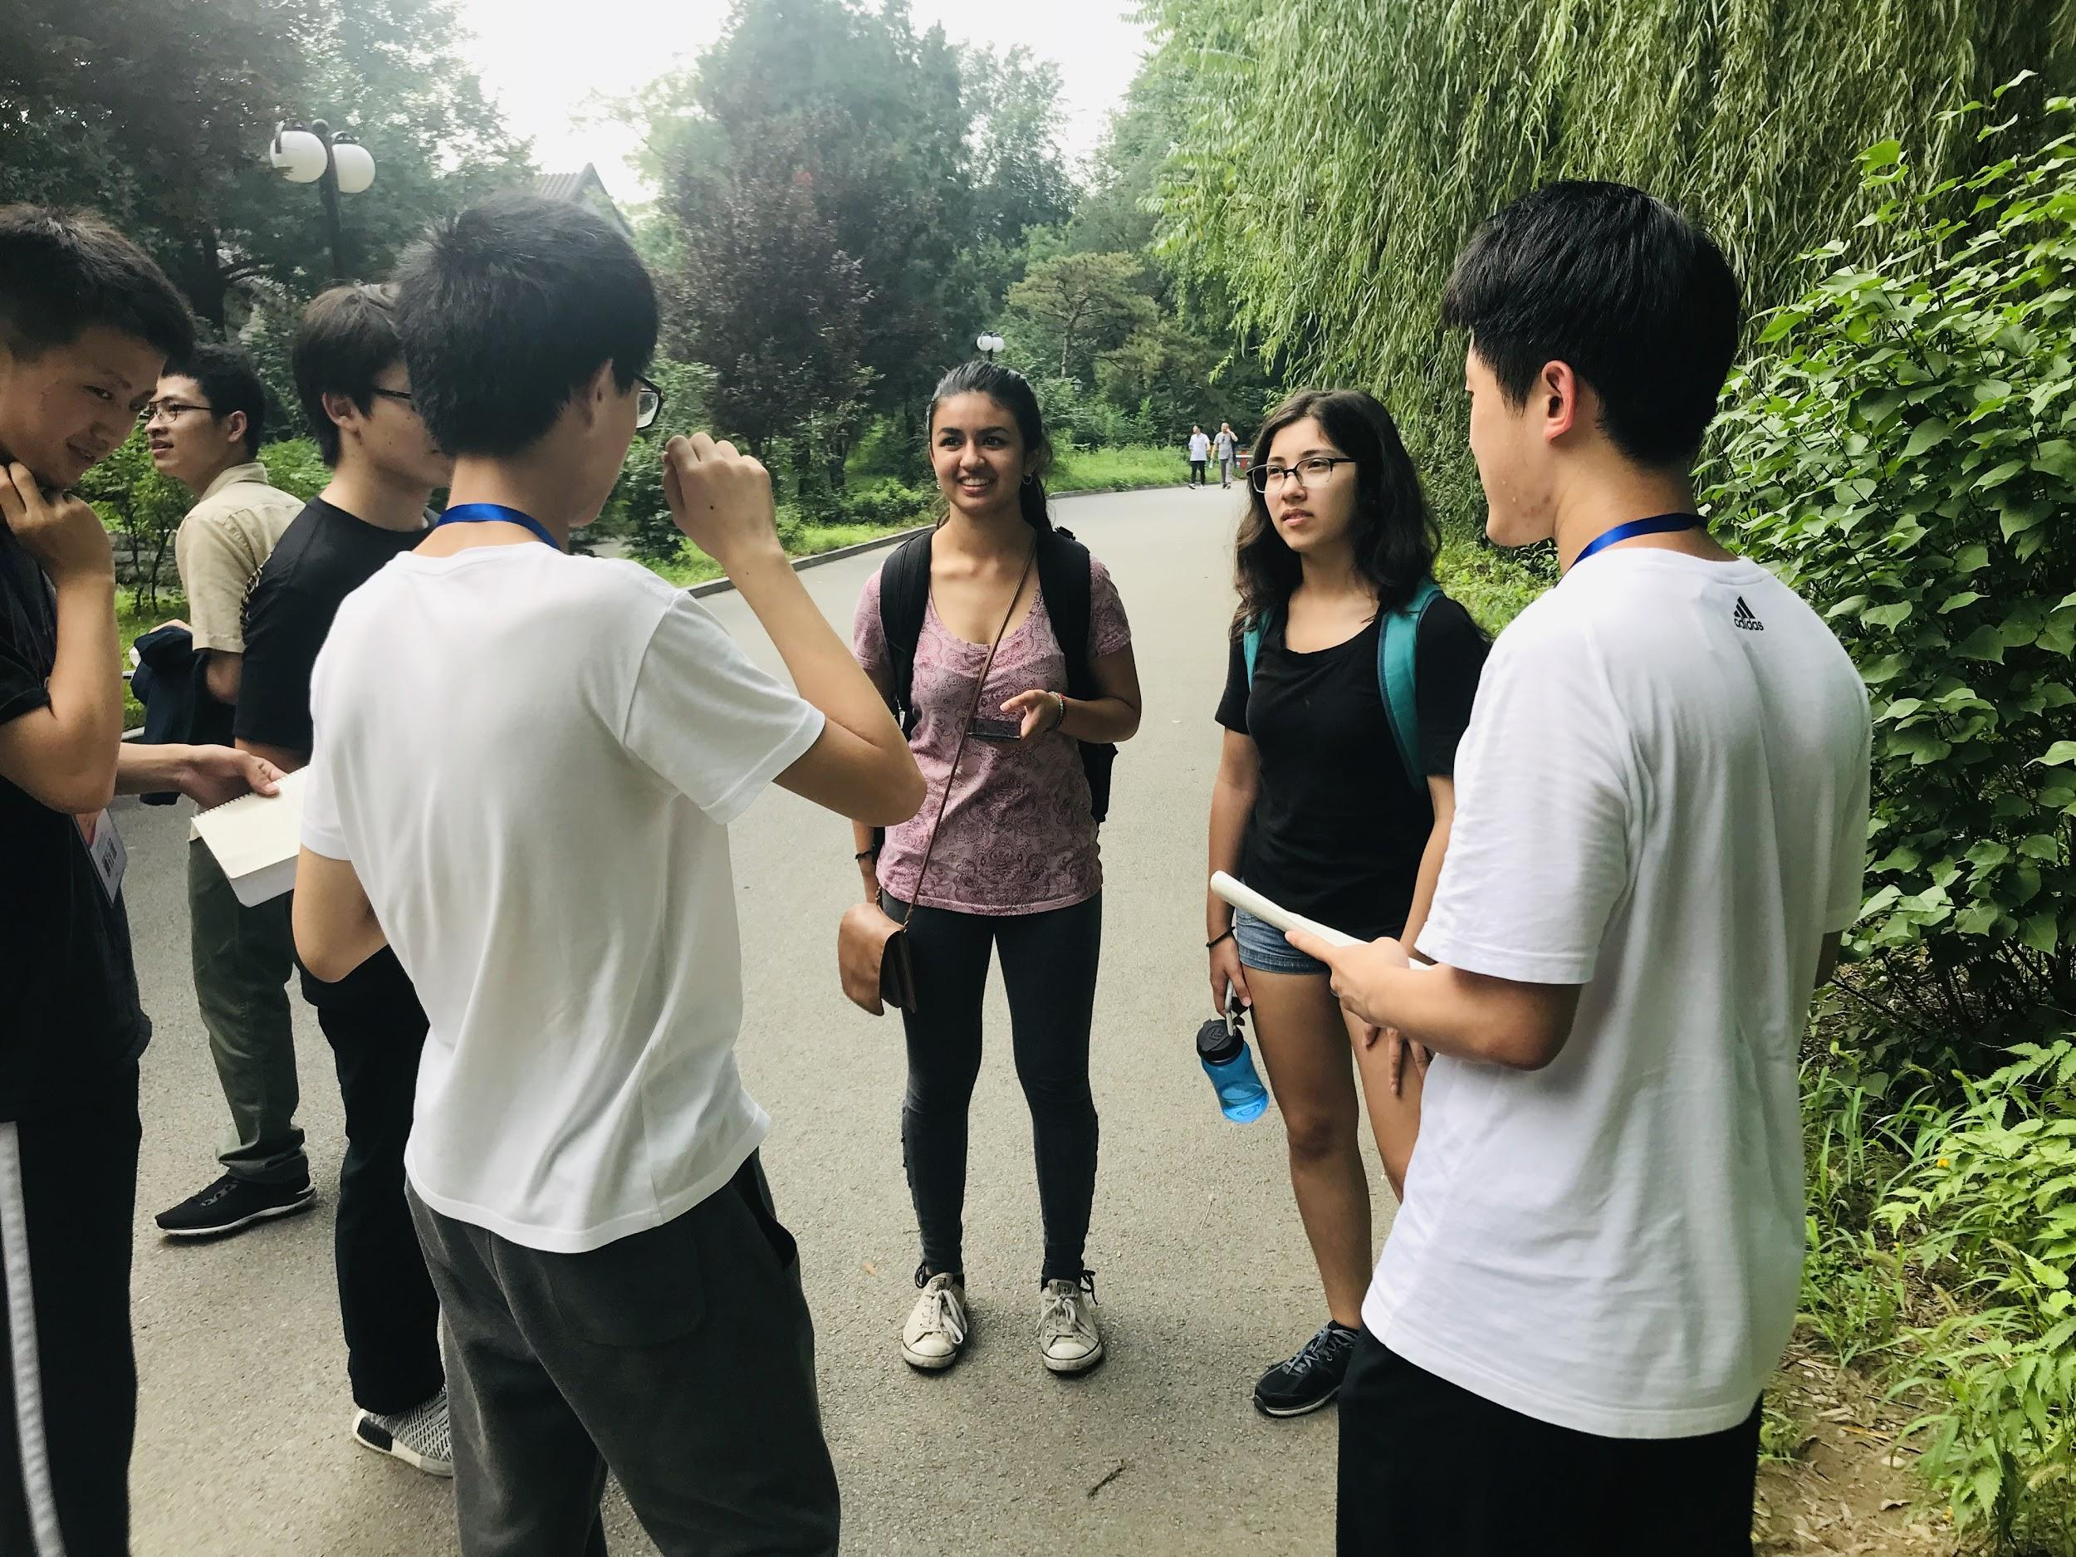
TWO FEMALE COLLEGE STUDENTS VISITING THE CAMPUS, JANE AND ANN
“
The environment is quite good in Beijing, except for the high temperature…………public transportation in Beijing is much more convenient, especially the subways. But there are too many cars, making it a crowded environment we live in.
”

Slide 8
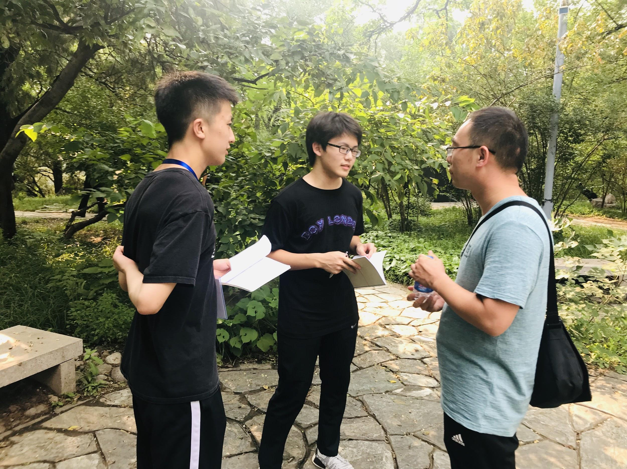
BILL, A MIDDLE AGED MAN FROM ZHEJIANG, WORRIED ABOUT THE PROBLEM IN HOSPITALS
“
Looking a doctor might be a big problem. Some of the hospitals are full of people all the time, while in some other hospitals, great vacancy exists. In addition, public still cannot classify trash both accurately and correctly,
”

Slide 9
How we generated HMW
Record
collate
Integrate
Sort
compare

Slide 10
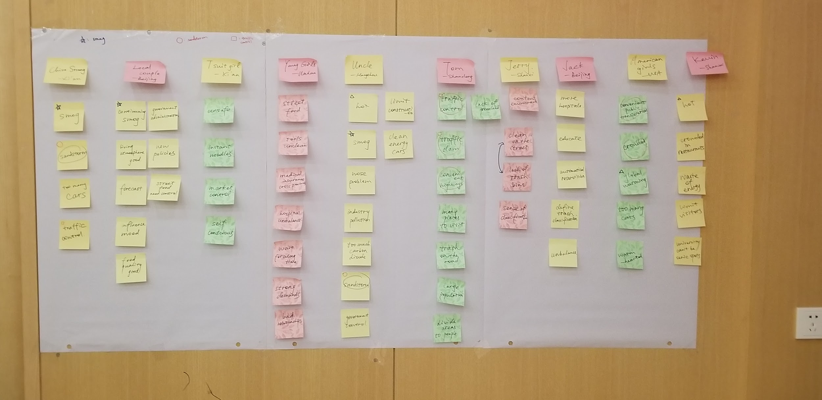
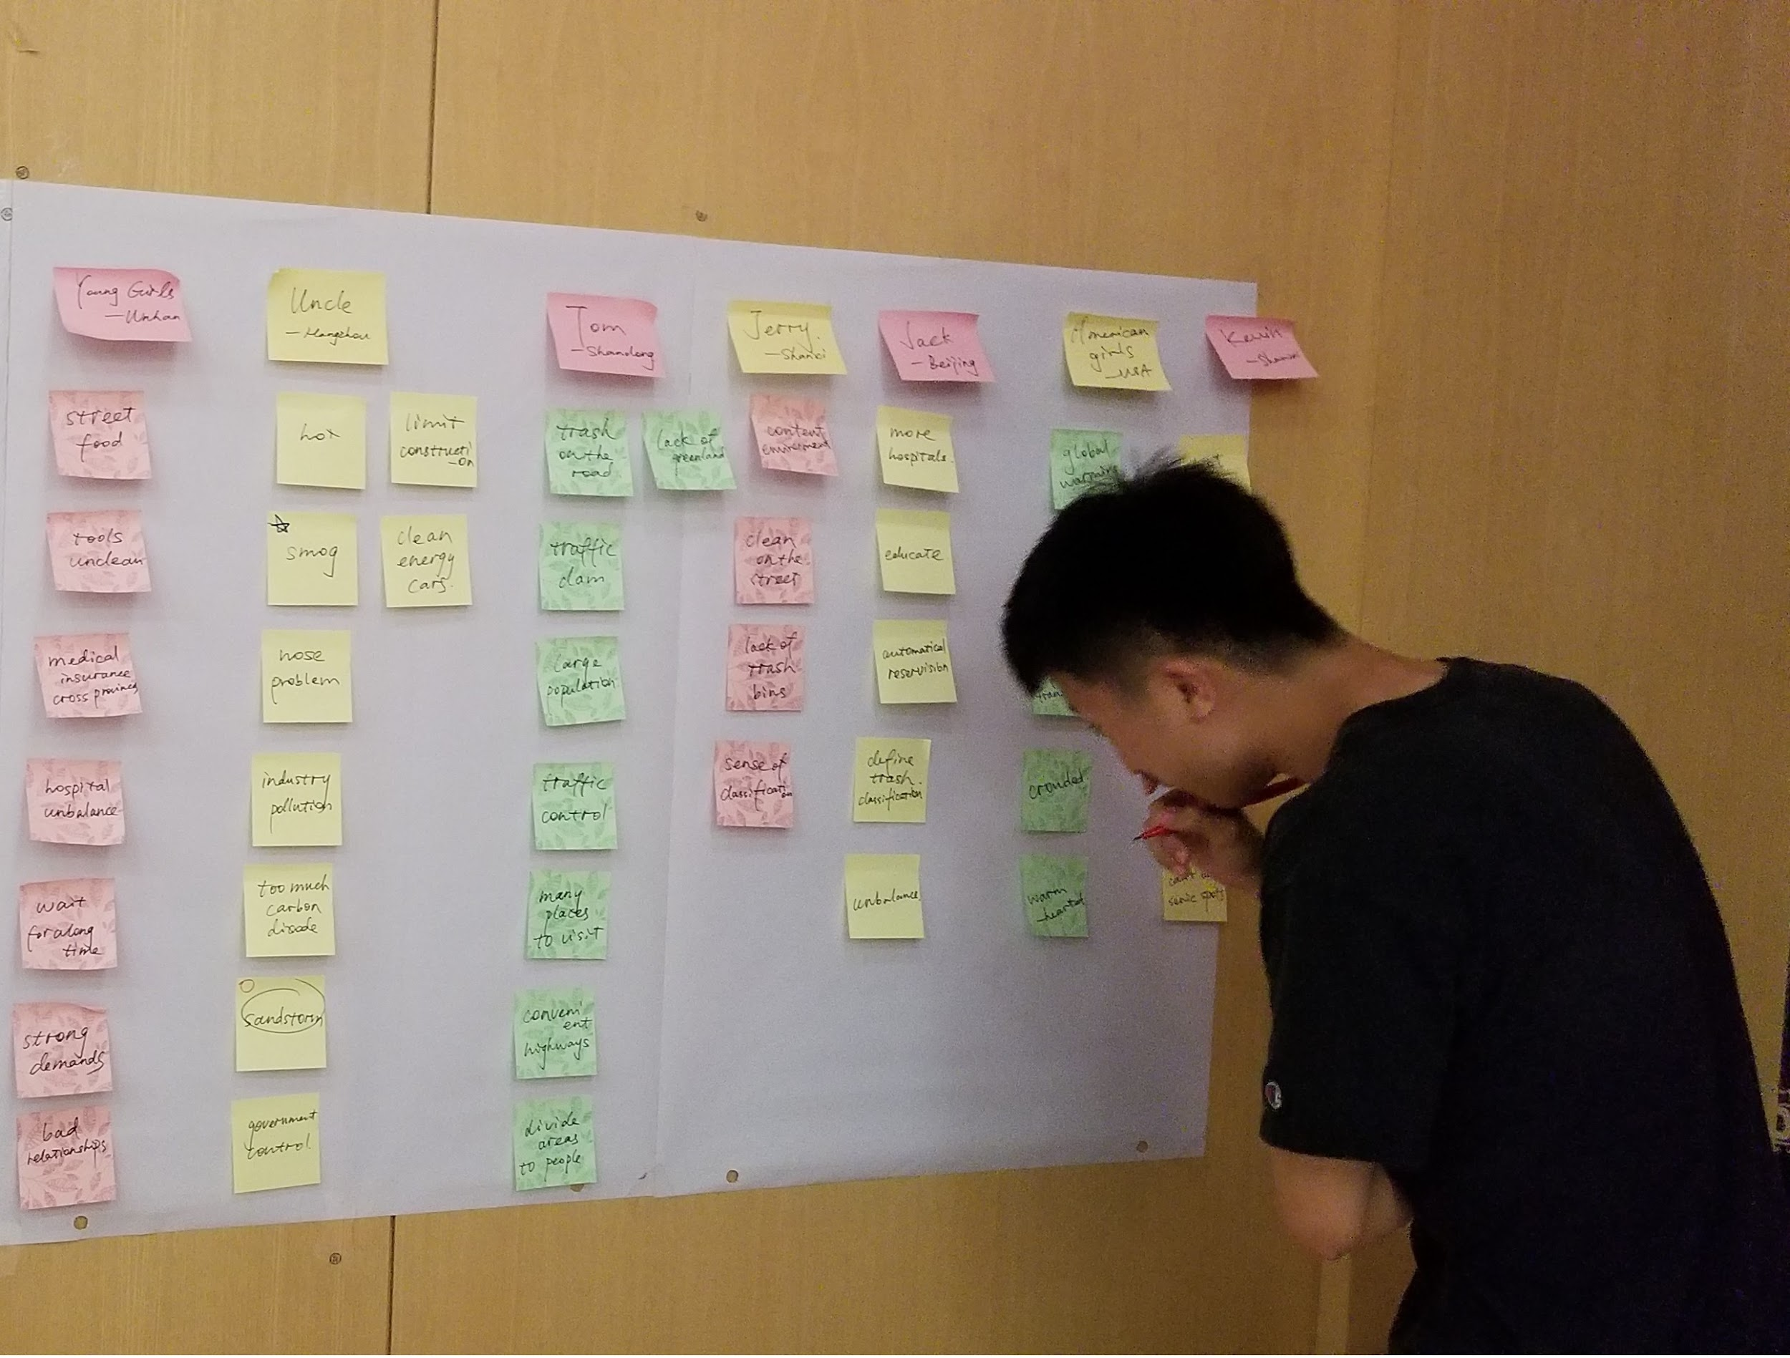
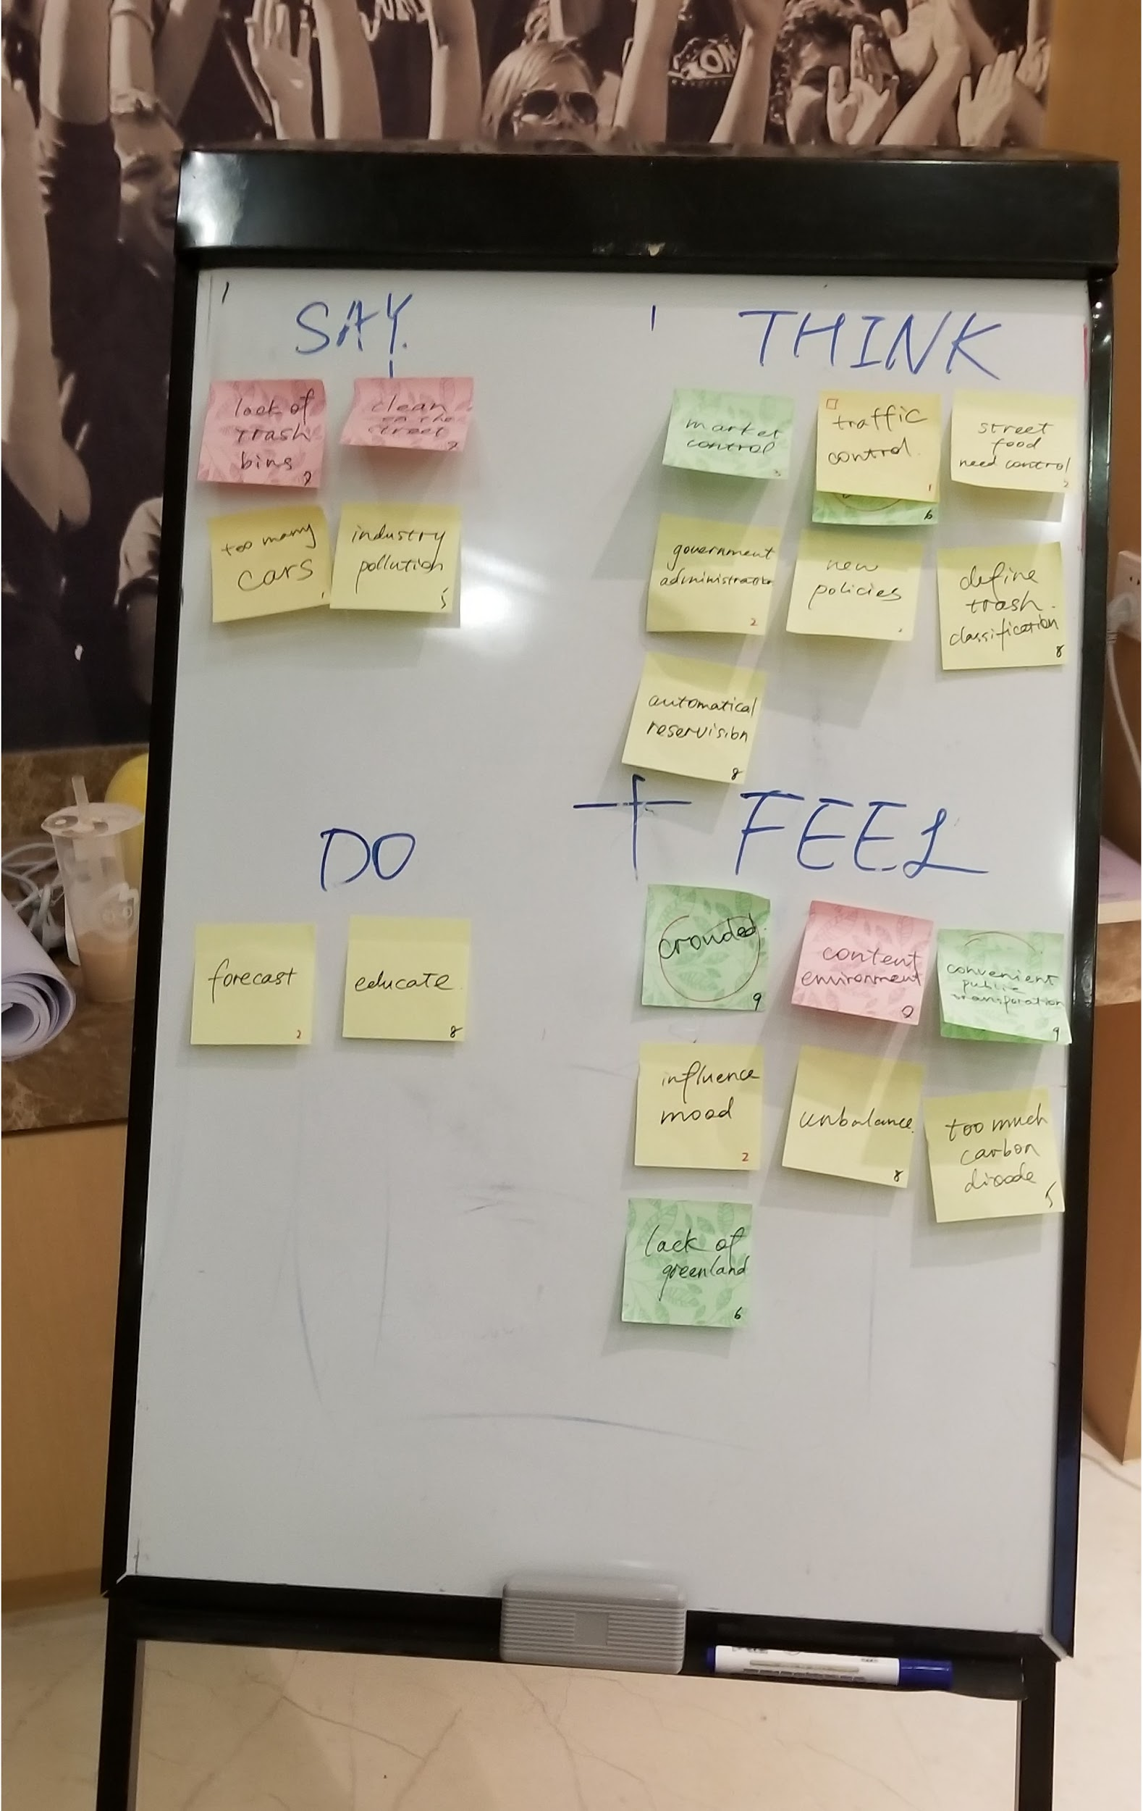
Needfinding
integrate
sort
collate

Slide 11
POV AND HWM
7.24-7.25 Tue & Wed

Slide 12
FIND OUT PROBLEMS
COMPARE
FIND OUT SUPPRESS
FIND OUT CONSTRUCTION
FIND OUT INTERESTING POINTS

Slide 13
GENERATE POVs
ACCORDING TO CONSTRUCTIONS, SUPPRESSES, INTERESTING POINTS
ACCORDING TO QUOTE
BRAINSTORM
CONCLUDE

Slide 14
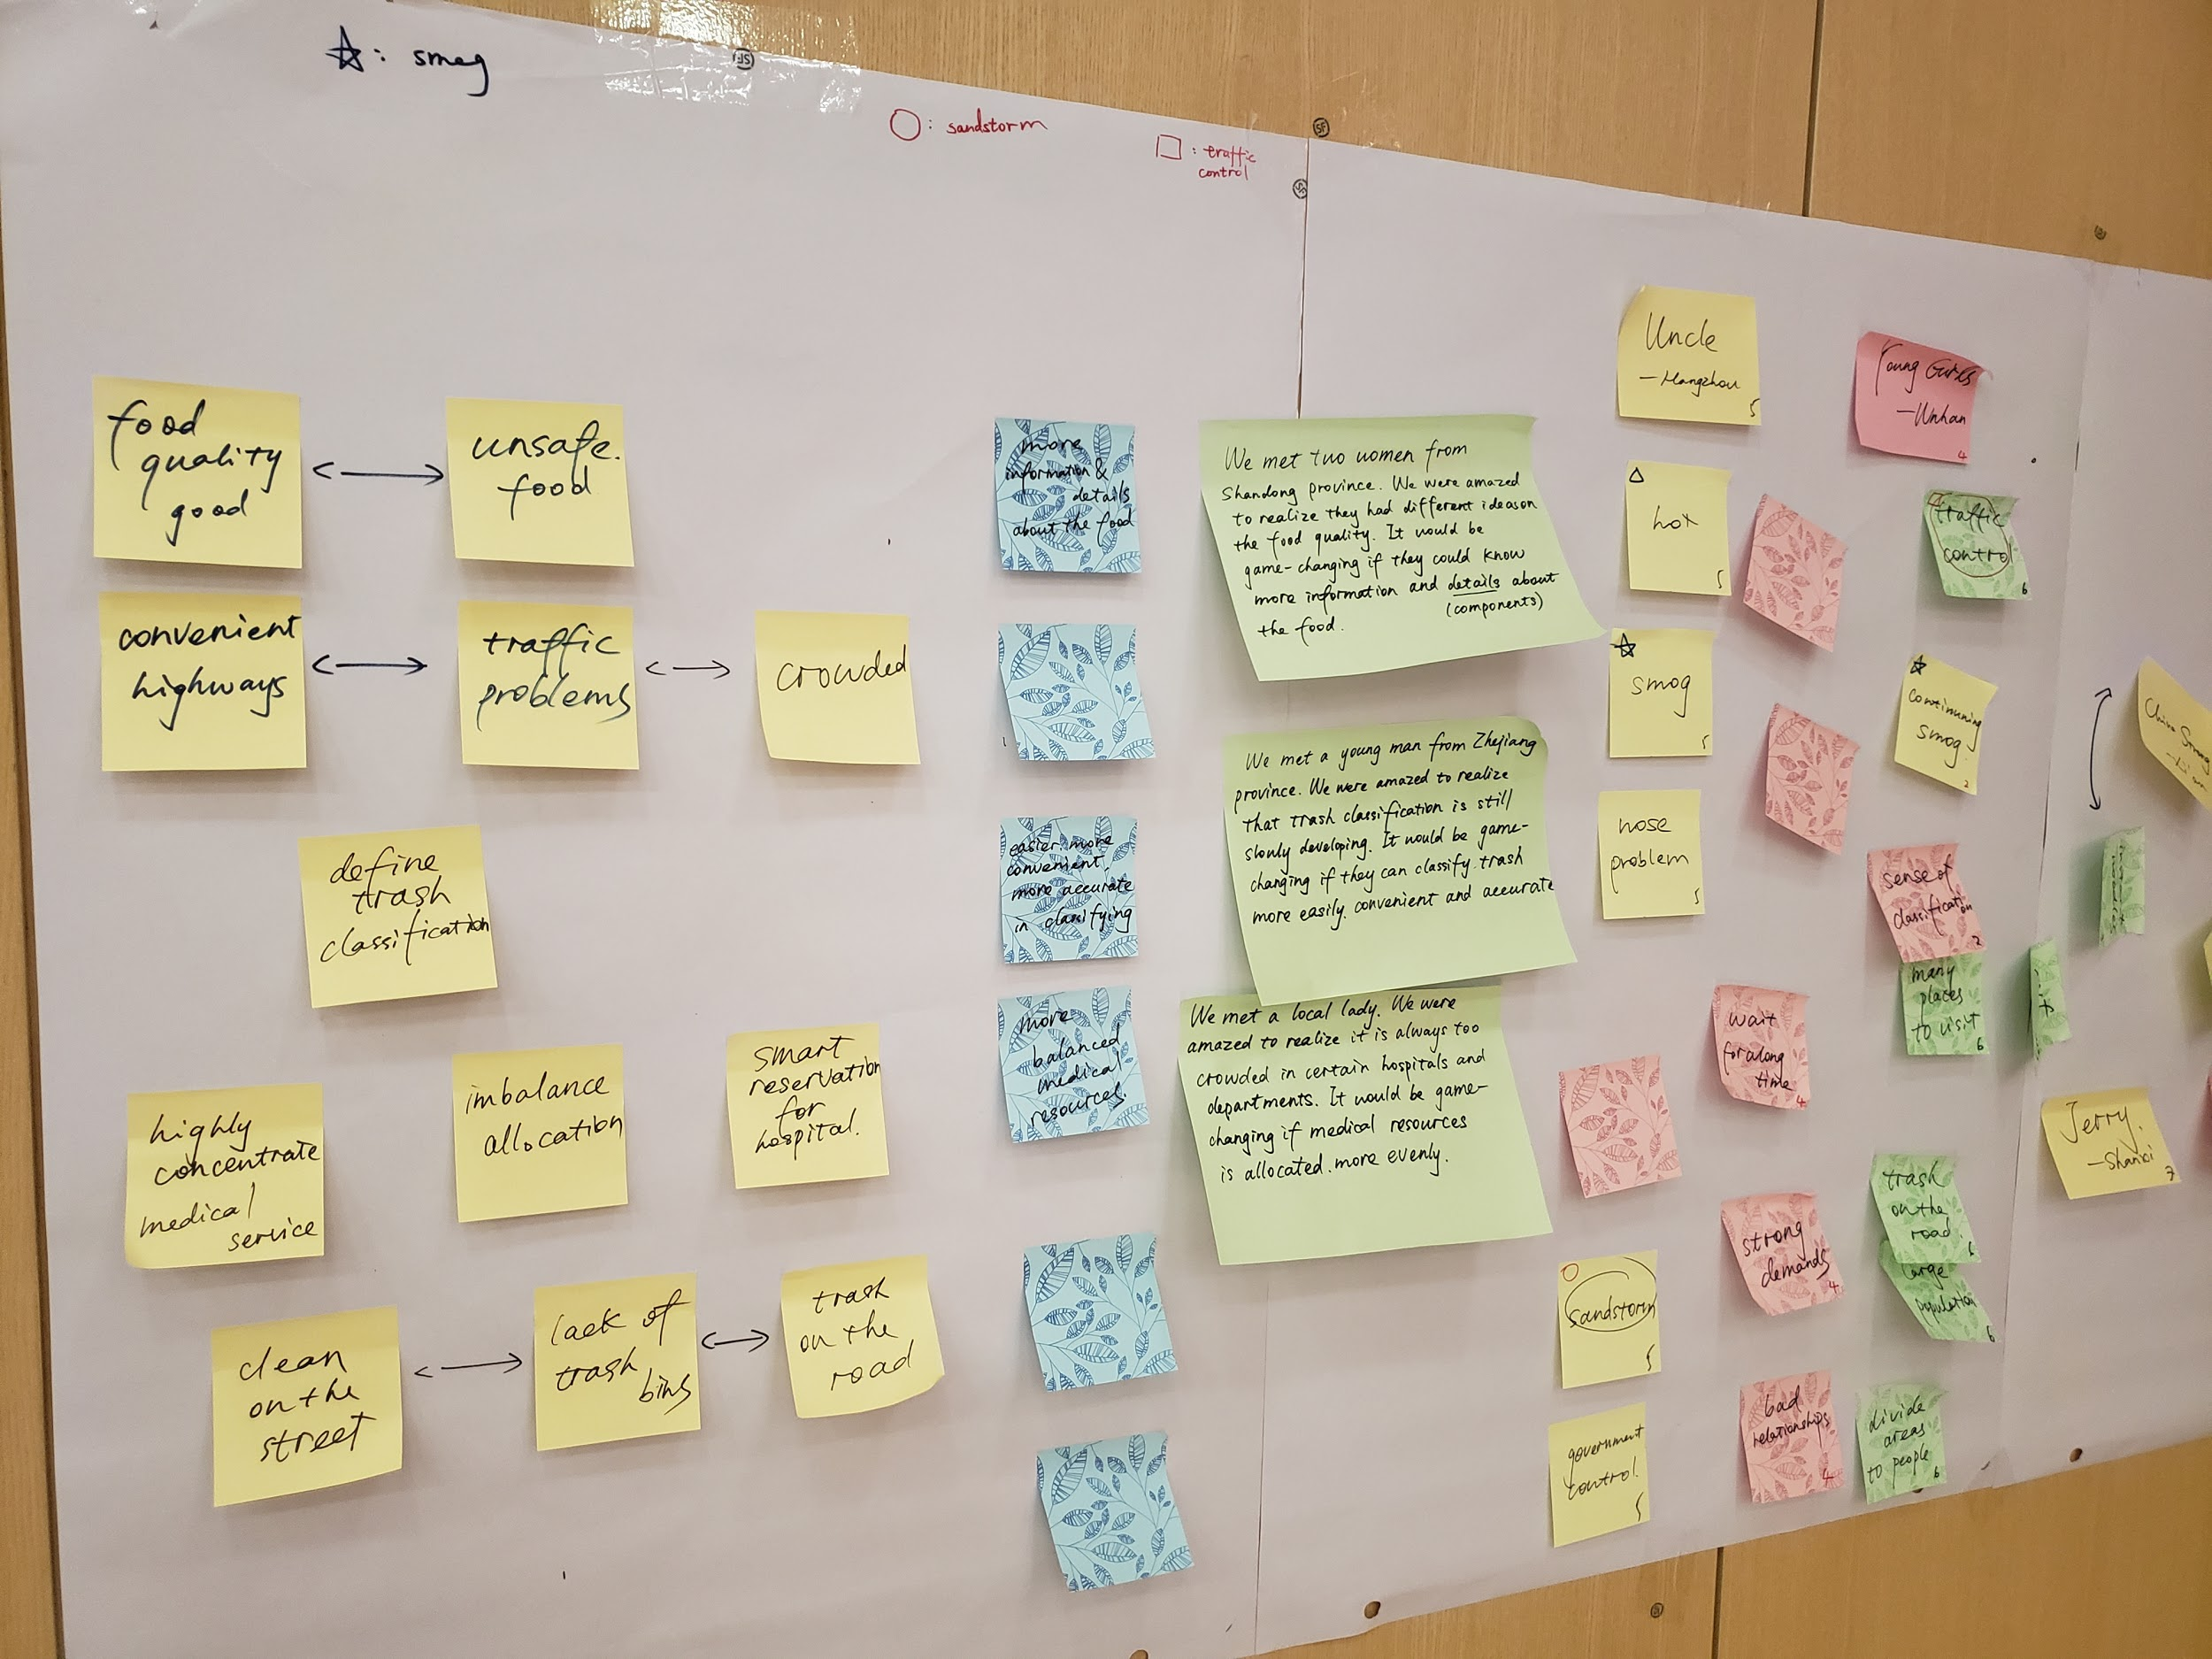

Slide 15
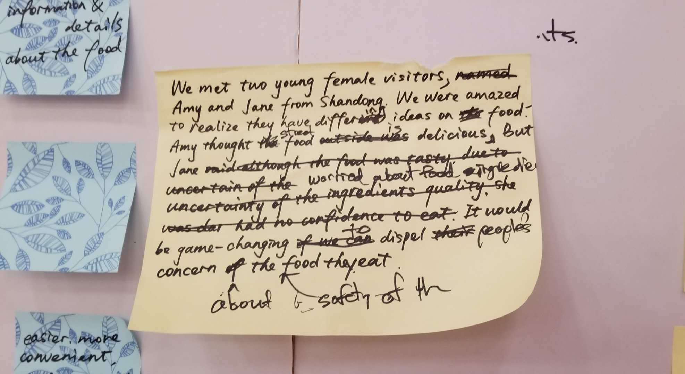
POINT OF VIEW

Slide 16
POINT OF VIEW
We met two young female visitors, Amy and Jane from Shandong.
We are amazed to realize that they have differing ideas on food. Amy thought street food is delicious, but Jane was worried about food ingredients.
It would be game-changing to if dispel people concern about the safety of food.

Slide 17
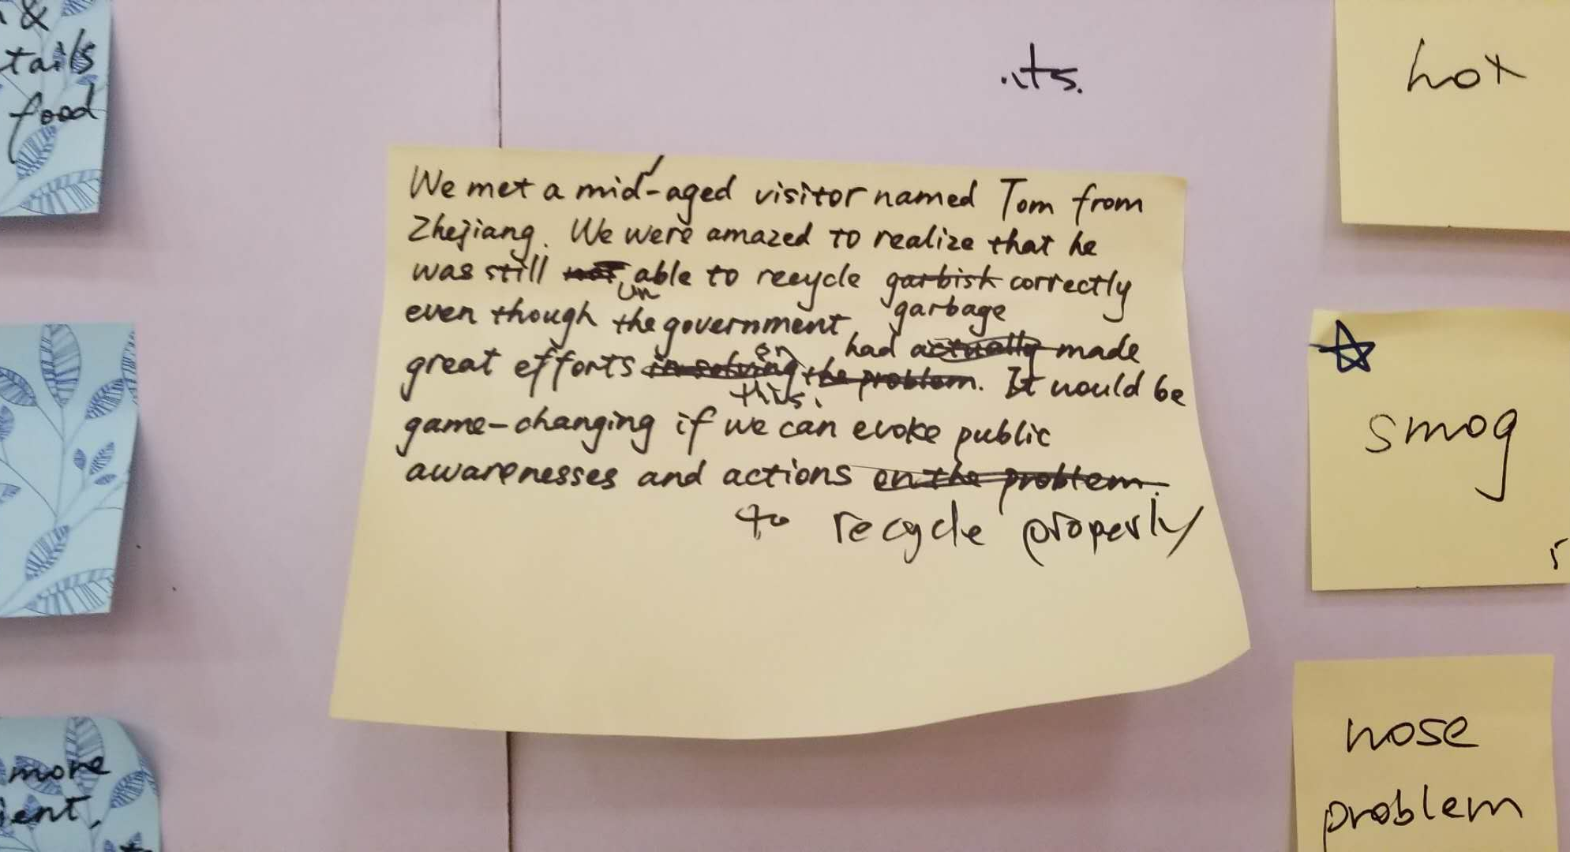
POINT OF VIEW

Slide 18
POINT OF VIEW
We met middle-aged visitor Tom from Zhejiang.
We were amazed to realize that he was still unable to recycle garbage correctly even though the government had made great efforts on this.
It would be game-changing if we can evoke public awareness and actions to recycle properly.

Slide 19
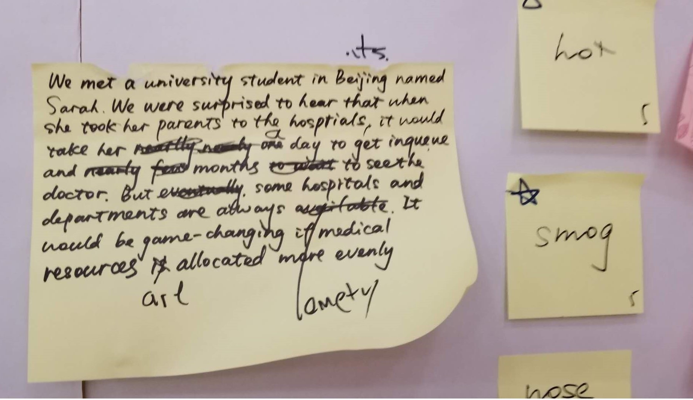
POINT OF VIEW

Slide 20
POINT OF VIEW
We met a university student in Beijing named Sarah. We were surprised to hear that when she took her parents to the hospitals, it would take her a day to get in queue and months to see the doctors. But some hospitals and departments are always empty.
It would be game-changing if medical resources are allocated more evenly.

Slide 21
HOW MIGHT WE
TO DIVIDE THE POV INTO SEVERAL TASKS
EACH OF TASK CAN IMPROVE THE PROBLEM
BRAINSTORM
FIND AS MUCH AS POSSIBLE

Slide 22
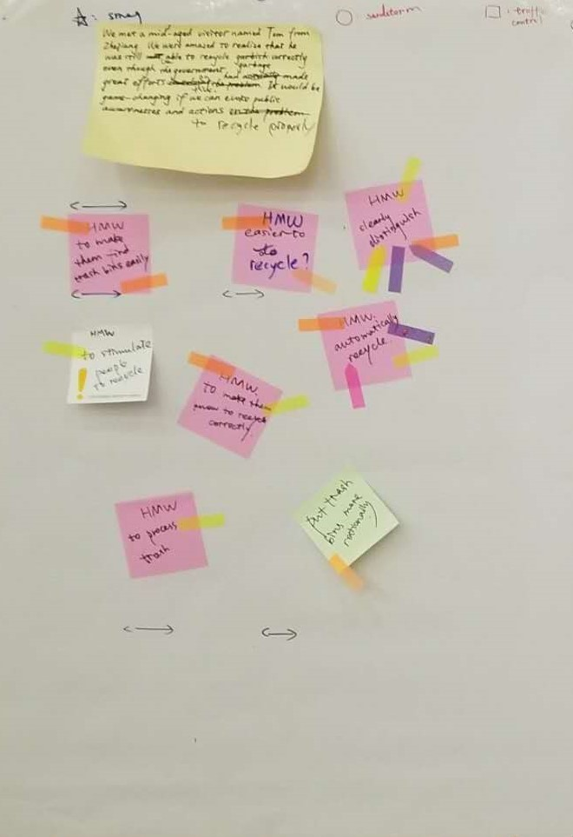
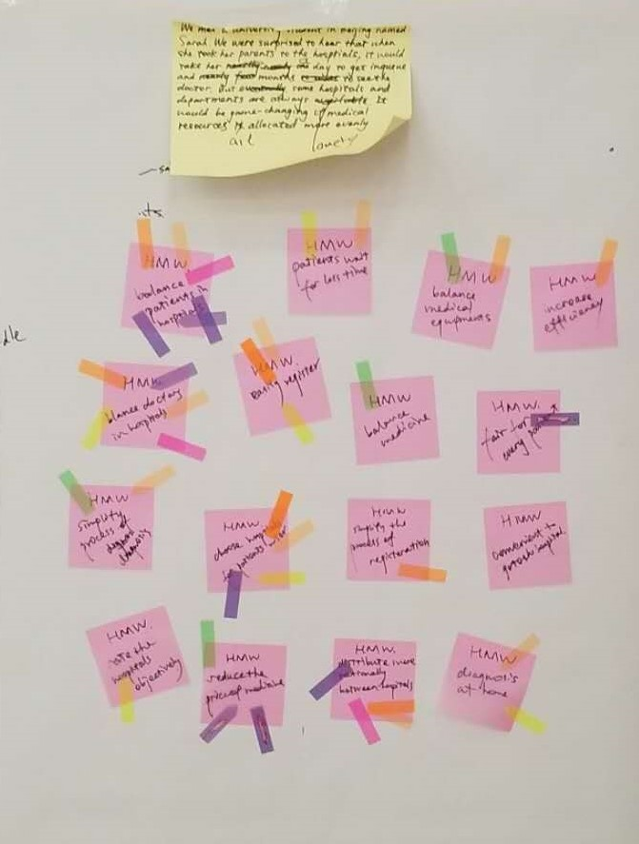
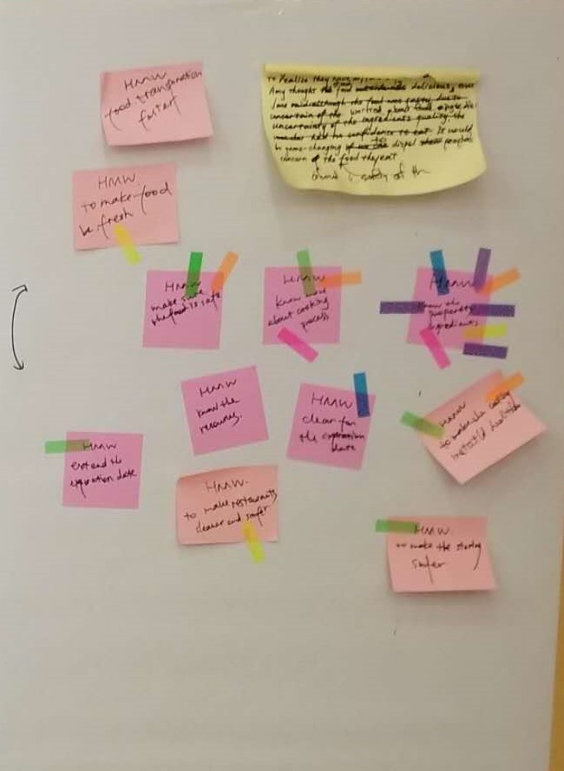
HOW MIGHT WE CHOOSE QUESTIONS AND VOTE:

Slide 23
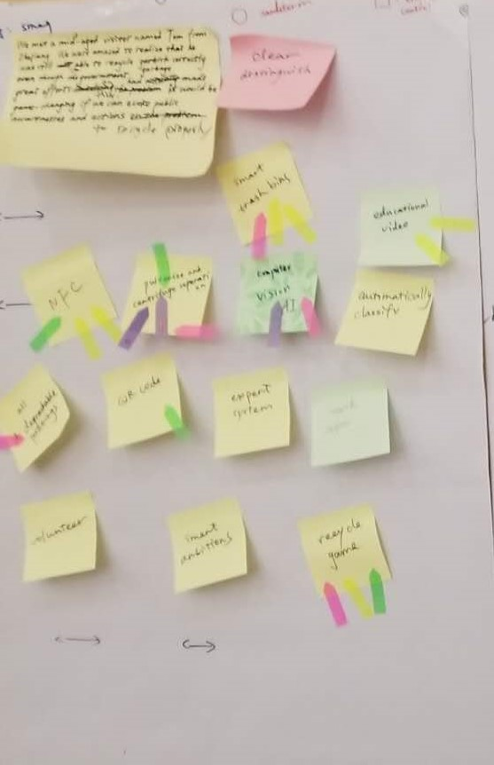
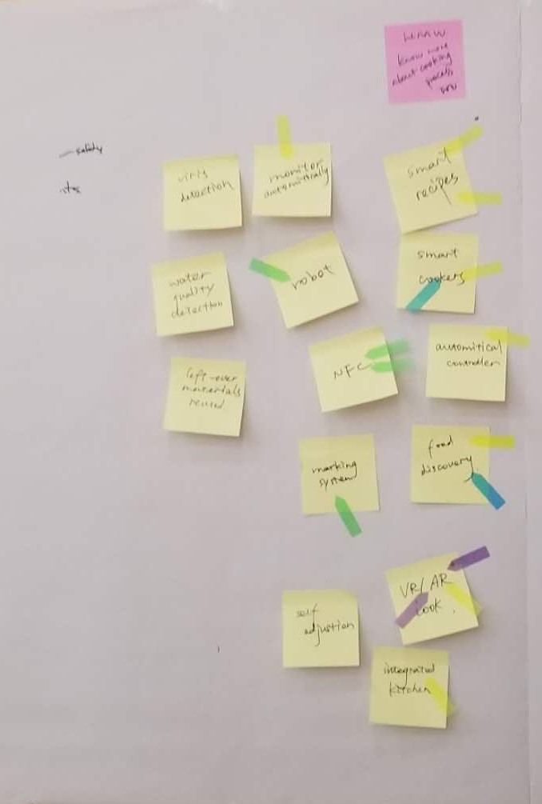
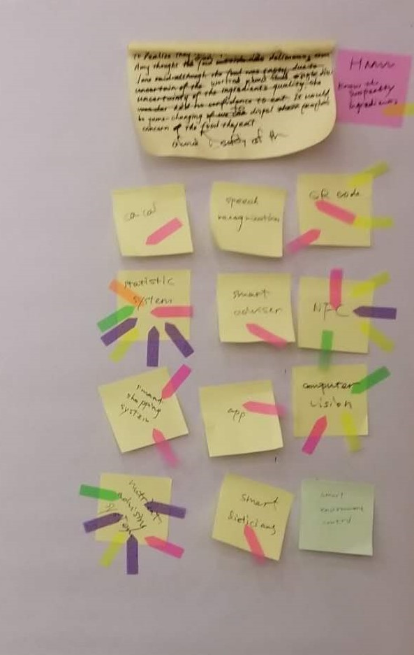
HOW MIGHT WE SOLVE QUESTIONS AND VOTE:
Notes:
VOTE FOR SOLUTION FOR THE HMW

Slide 24
Experience prototype and Low-fi Prototype
7.23-7.24 Mon & Tue

Slide 25
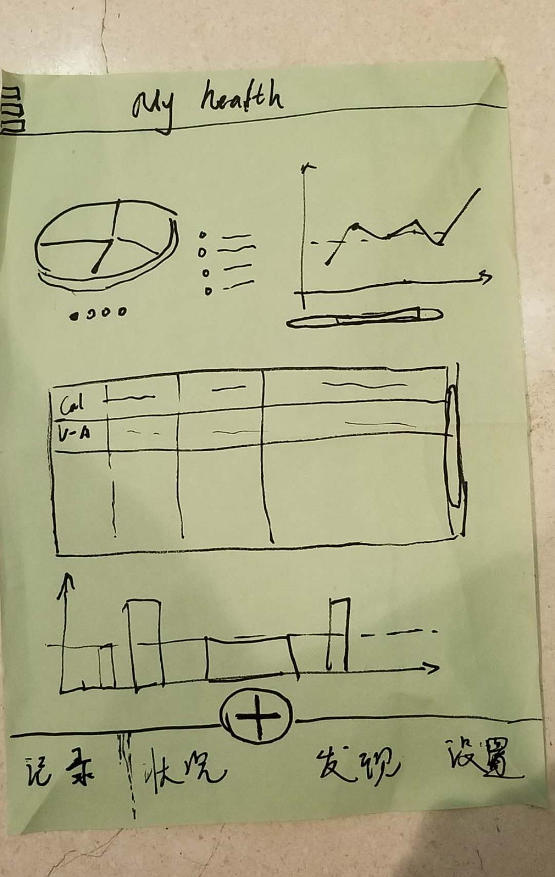
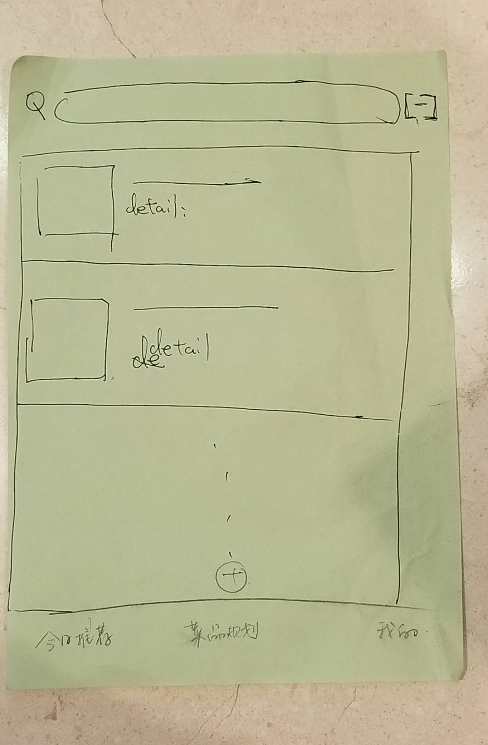
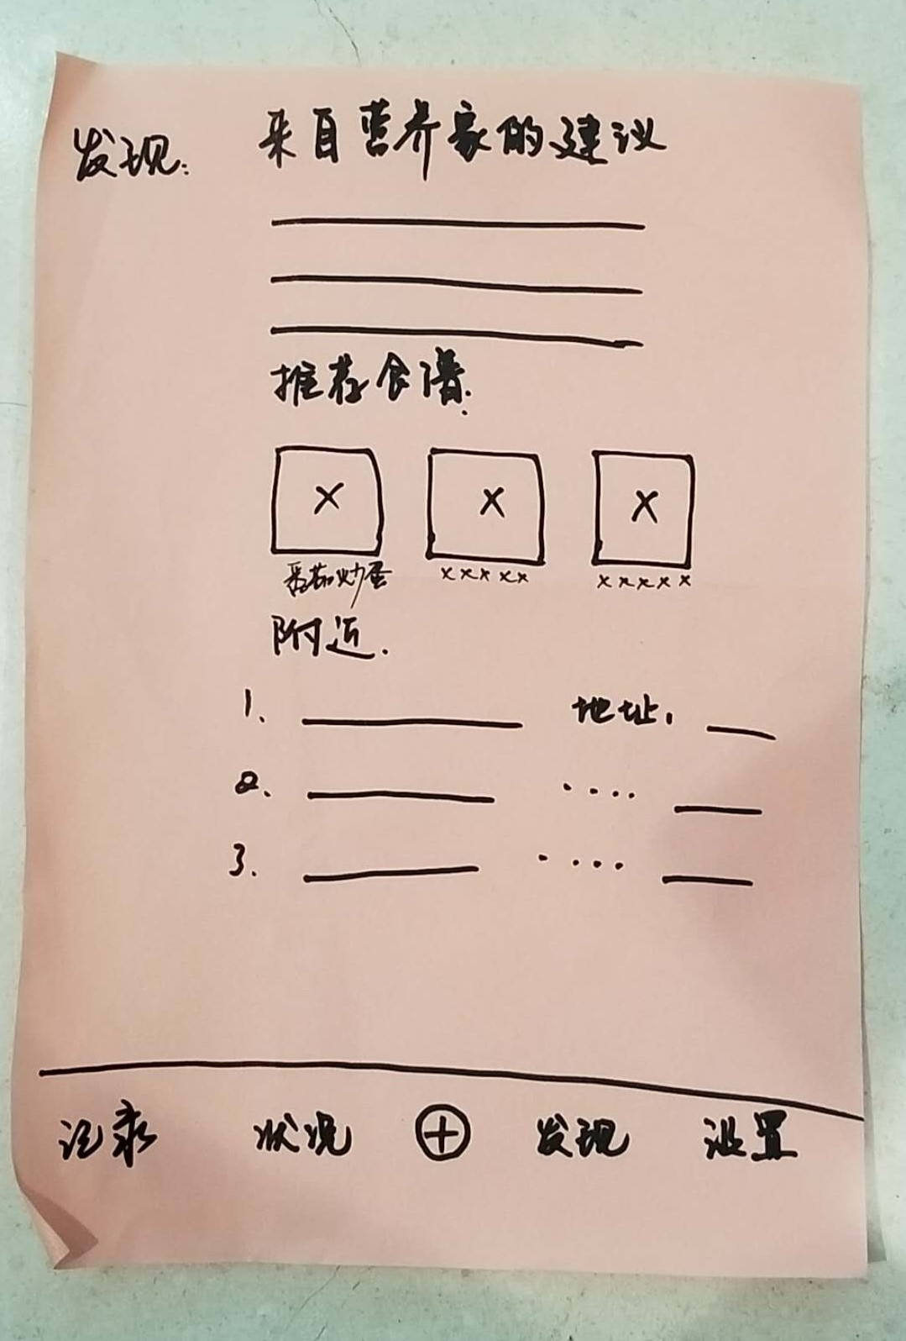
EXPERIENCE PROTOTYPE
My health statistics
Daily dishes recommendation
Suggestions from expert

Slide 26
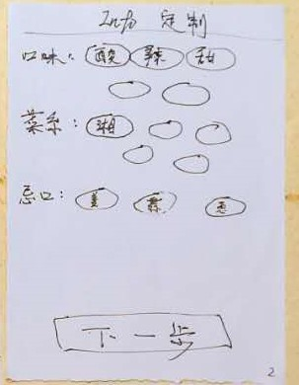
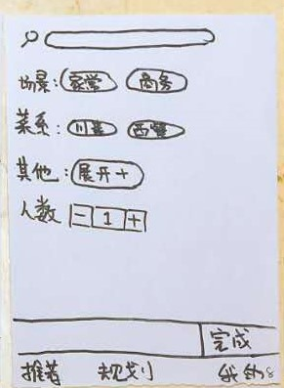
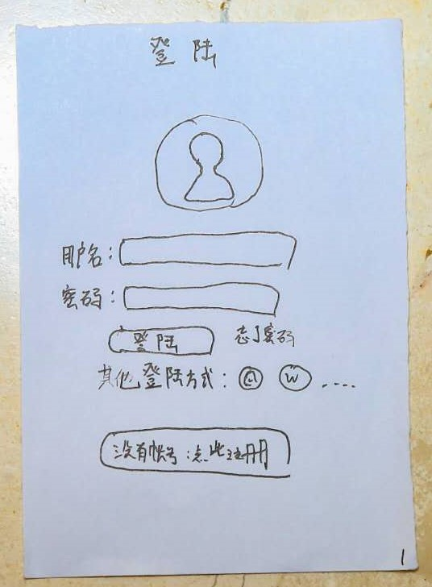
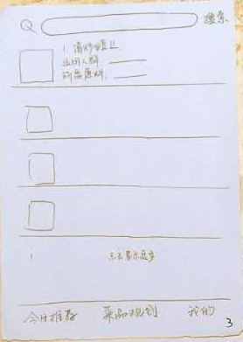
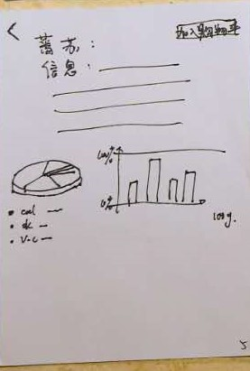
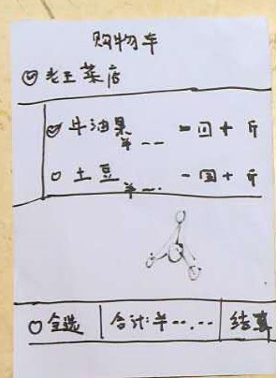
Low-Fi prototype

Slide 27
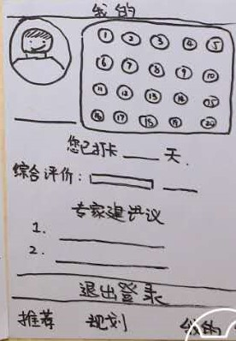
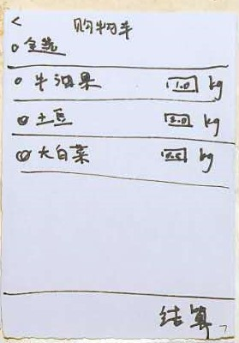
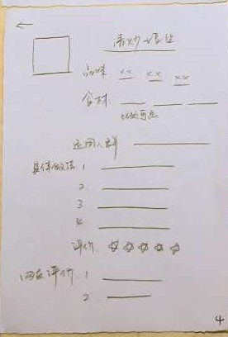
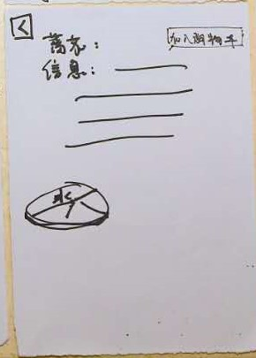
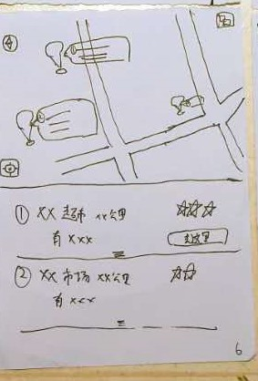
Low-Fi prototype

Slide 28
Medium-Fi Prototype
4
7.25-7.26

Slide 29
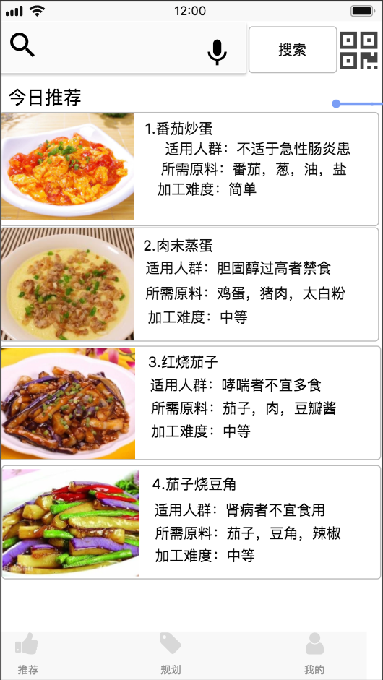
Task 1:
Find the right
Recommended recipe.
Place your screenshot here

Slide 30
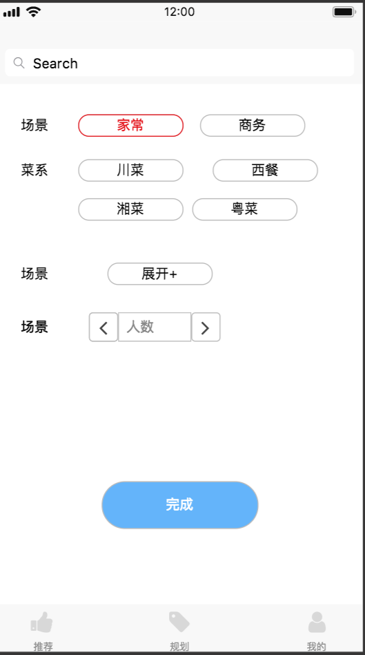
Task 2:
Planning a meal for a dinner party.
Place your screenshot here

Slide 31
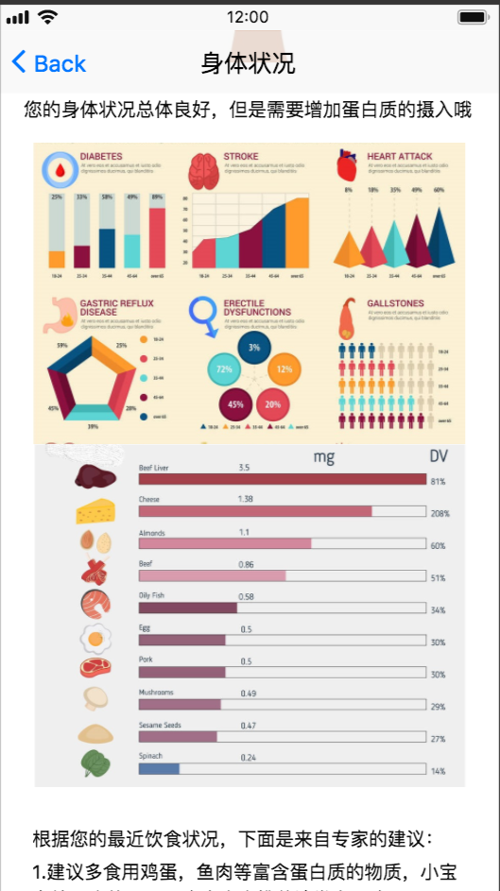
TASK 3：
See how healthy of my recently eating.
Place your screenshot here

Slide 32
Group Heuristic Evaluation

Slide 33
Group Heuristic Evaluation
Buttons haven’t been lined up.
More options of personal preferences should be added.

Slide 34
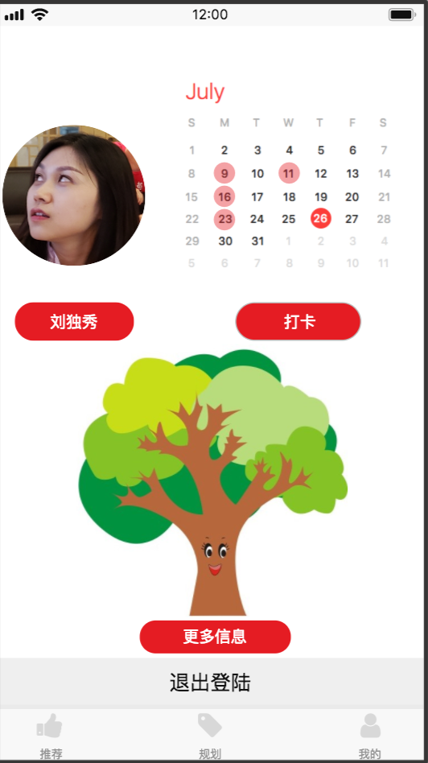
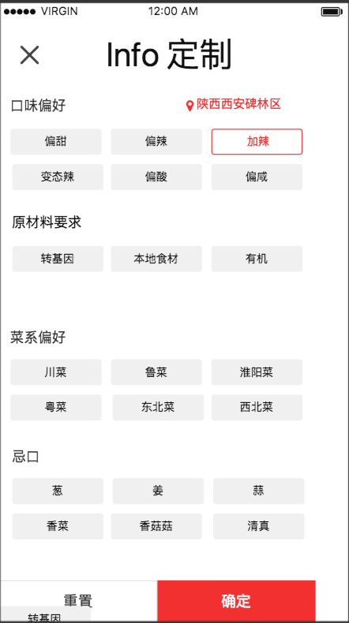
Medium-Fi Prototype #2: Key Changes

Slide 35
Usability Test
The buttons are too small to touch.
The operations are not very fluent.
Improve the comment feature.

Slide 36
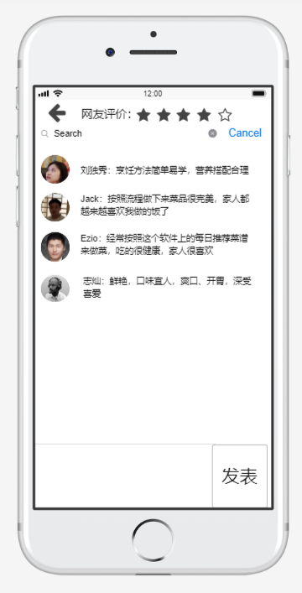
Medium-Fi Prototype #3:
Place your screenshot here
Bugs fixed

Slide 37

Conclusion
Big social and environmental problems can be simplified into small particular tasks.
And we are able to put these ideas into reality using powerful designing tools and hard work.
All in all, it feels good to make the lives of human beings better.

Slide 38
Conclusion
Project name: health assistant
URL: https://modao.cc/app/vAppe1XHPMYdnq5BQgIiBSt5EtPDHzk

